Slide 1

Quality Assurance Avengers
Smashing Bugs Without Feelings

Slide 2




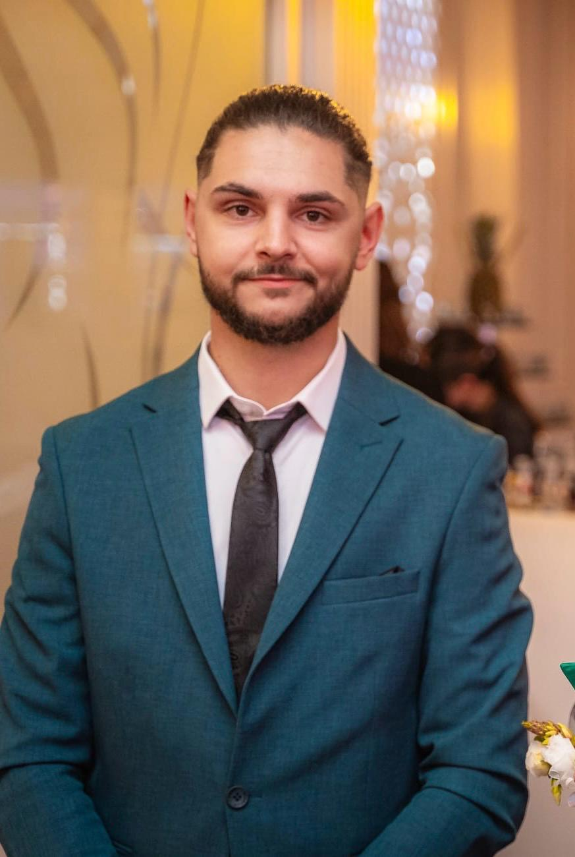
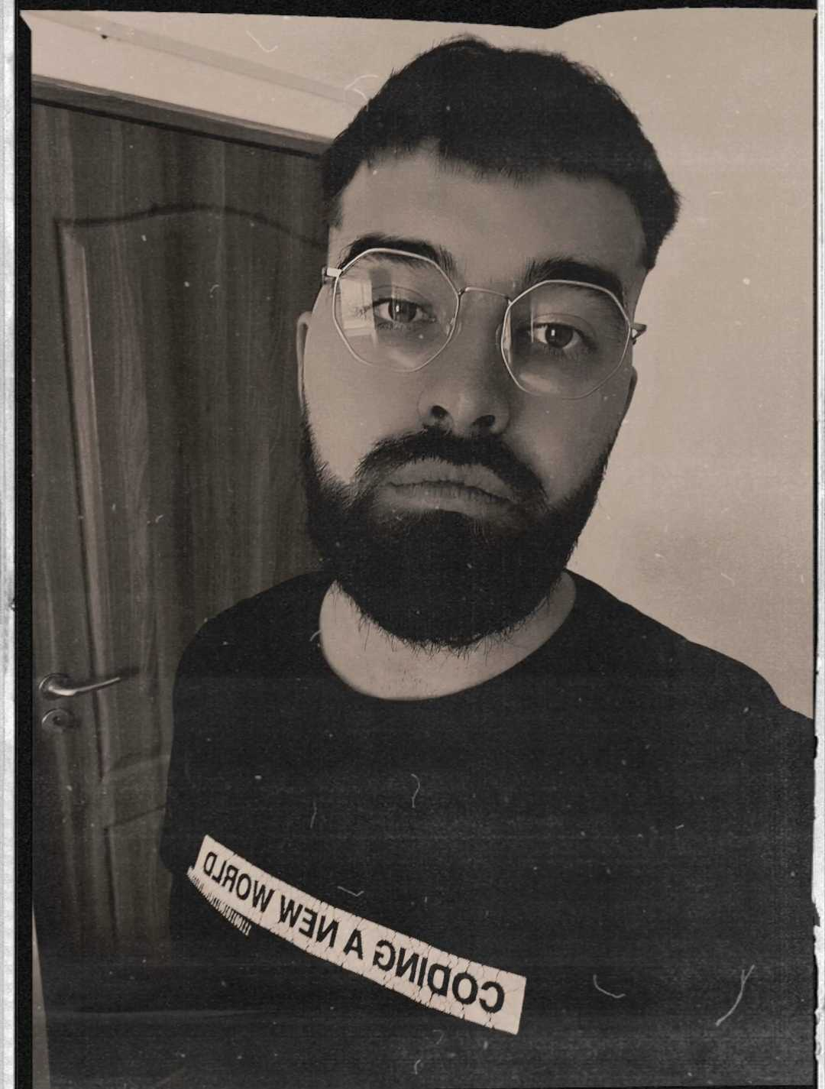
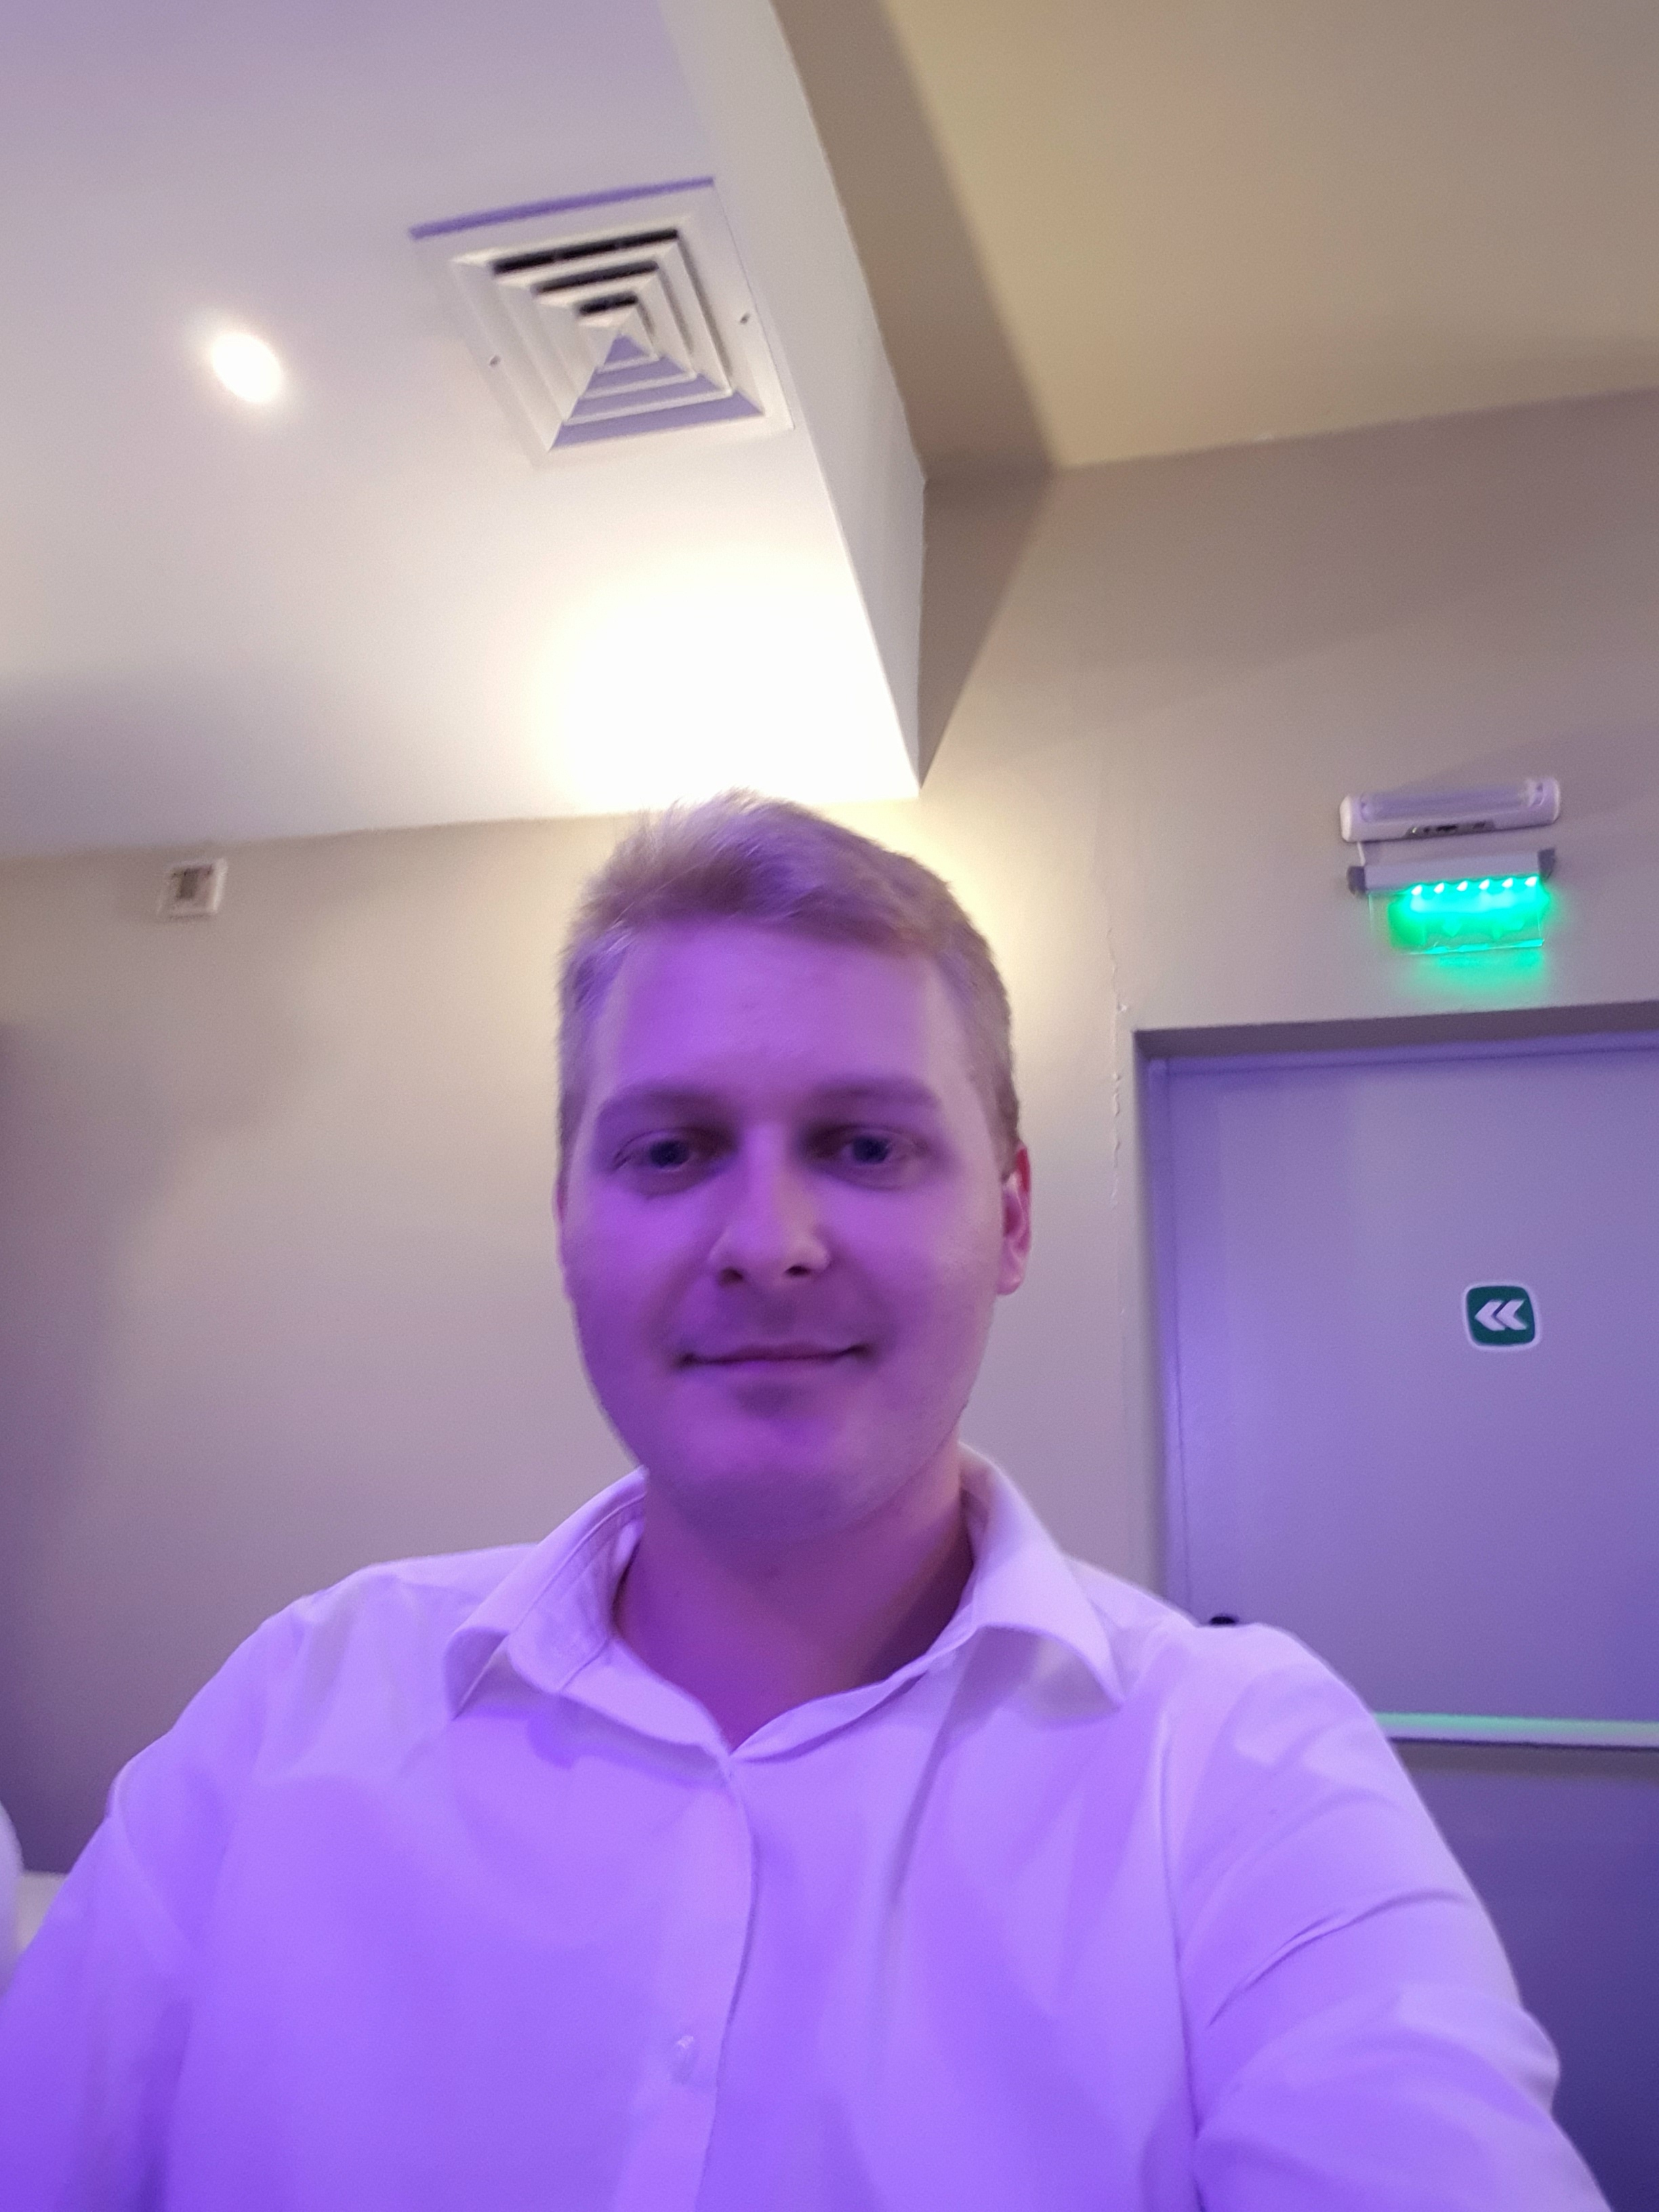
Team Players
Roxana Ojog
Project Manager
Ala Isac
Quality Assurance Tester
Team Leader
Brigitta Lőrincz
Quality Assurance Tester
Scrum Master
Alexandra Elena Mircea
Quality Assurance Tester
Alexandru Ciomag
Quality Assurance Tester
Stefan Gherghescu
Quality Assurance Tester
Vlad Bagacean
Quality assurance Tester

Slide 3
Cashify Is Your Money Manager
Cashify application is a financial management platform designed to assist users in tracking their income and expenses. This test plan focus on ensuring the functionality, usability and performance of the Cashify application through comprehensive testing methodologies.

Slide 4

The Most Critical Bug
The most critical bug that me and my team agreed on is the Log In credentials. This is a vulnerability in the authentication system of the website, allowing unauthorized access to user data and administrative controls. It was discovered that any users can exploit this vulnerability to gain unauthorized access to user accounts, manipulate data.

Slide 5

For Such Critical Situation, My Team Focused On Good Communications With Stakeholders
Transparently communicate with stakeholders, including users, and project manager, about the security incident and the actions being taken to address it. Provide regular updates on the progress of the fix and any changes to the website's availability or functionality.

Slide 6
Used Testing Tools and Methods Approached
TYPE OF TESTING
Functional Testing-Ensuring that all functionalities of the website work as expected, including navigation, user authentication, and data processing.
TESTING TOOLS
Tools that are required to test Cashify applications are:
Tracking tools (Jira, Trello, Test Rail, Google Sheets)
Bug Tracking tool:Test Rails
Communication tools (Trello, Slack, Zoom, E-mail)
TEST ENVIROMENT
To test the application, we used the following:
Hardware- PC, Mobile Device, Tablet
Product- Cashify Application
Operating System- Windows, Android, iOS

Slide 7
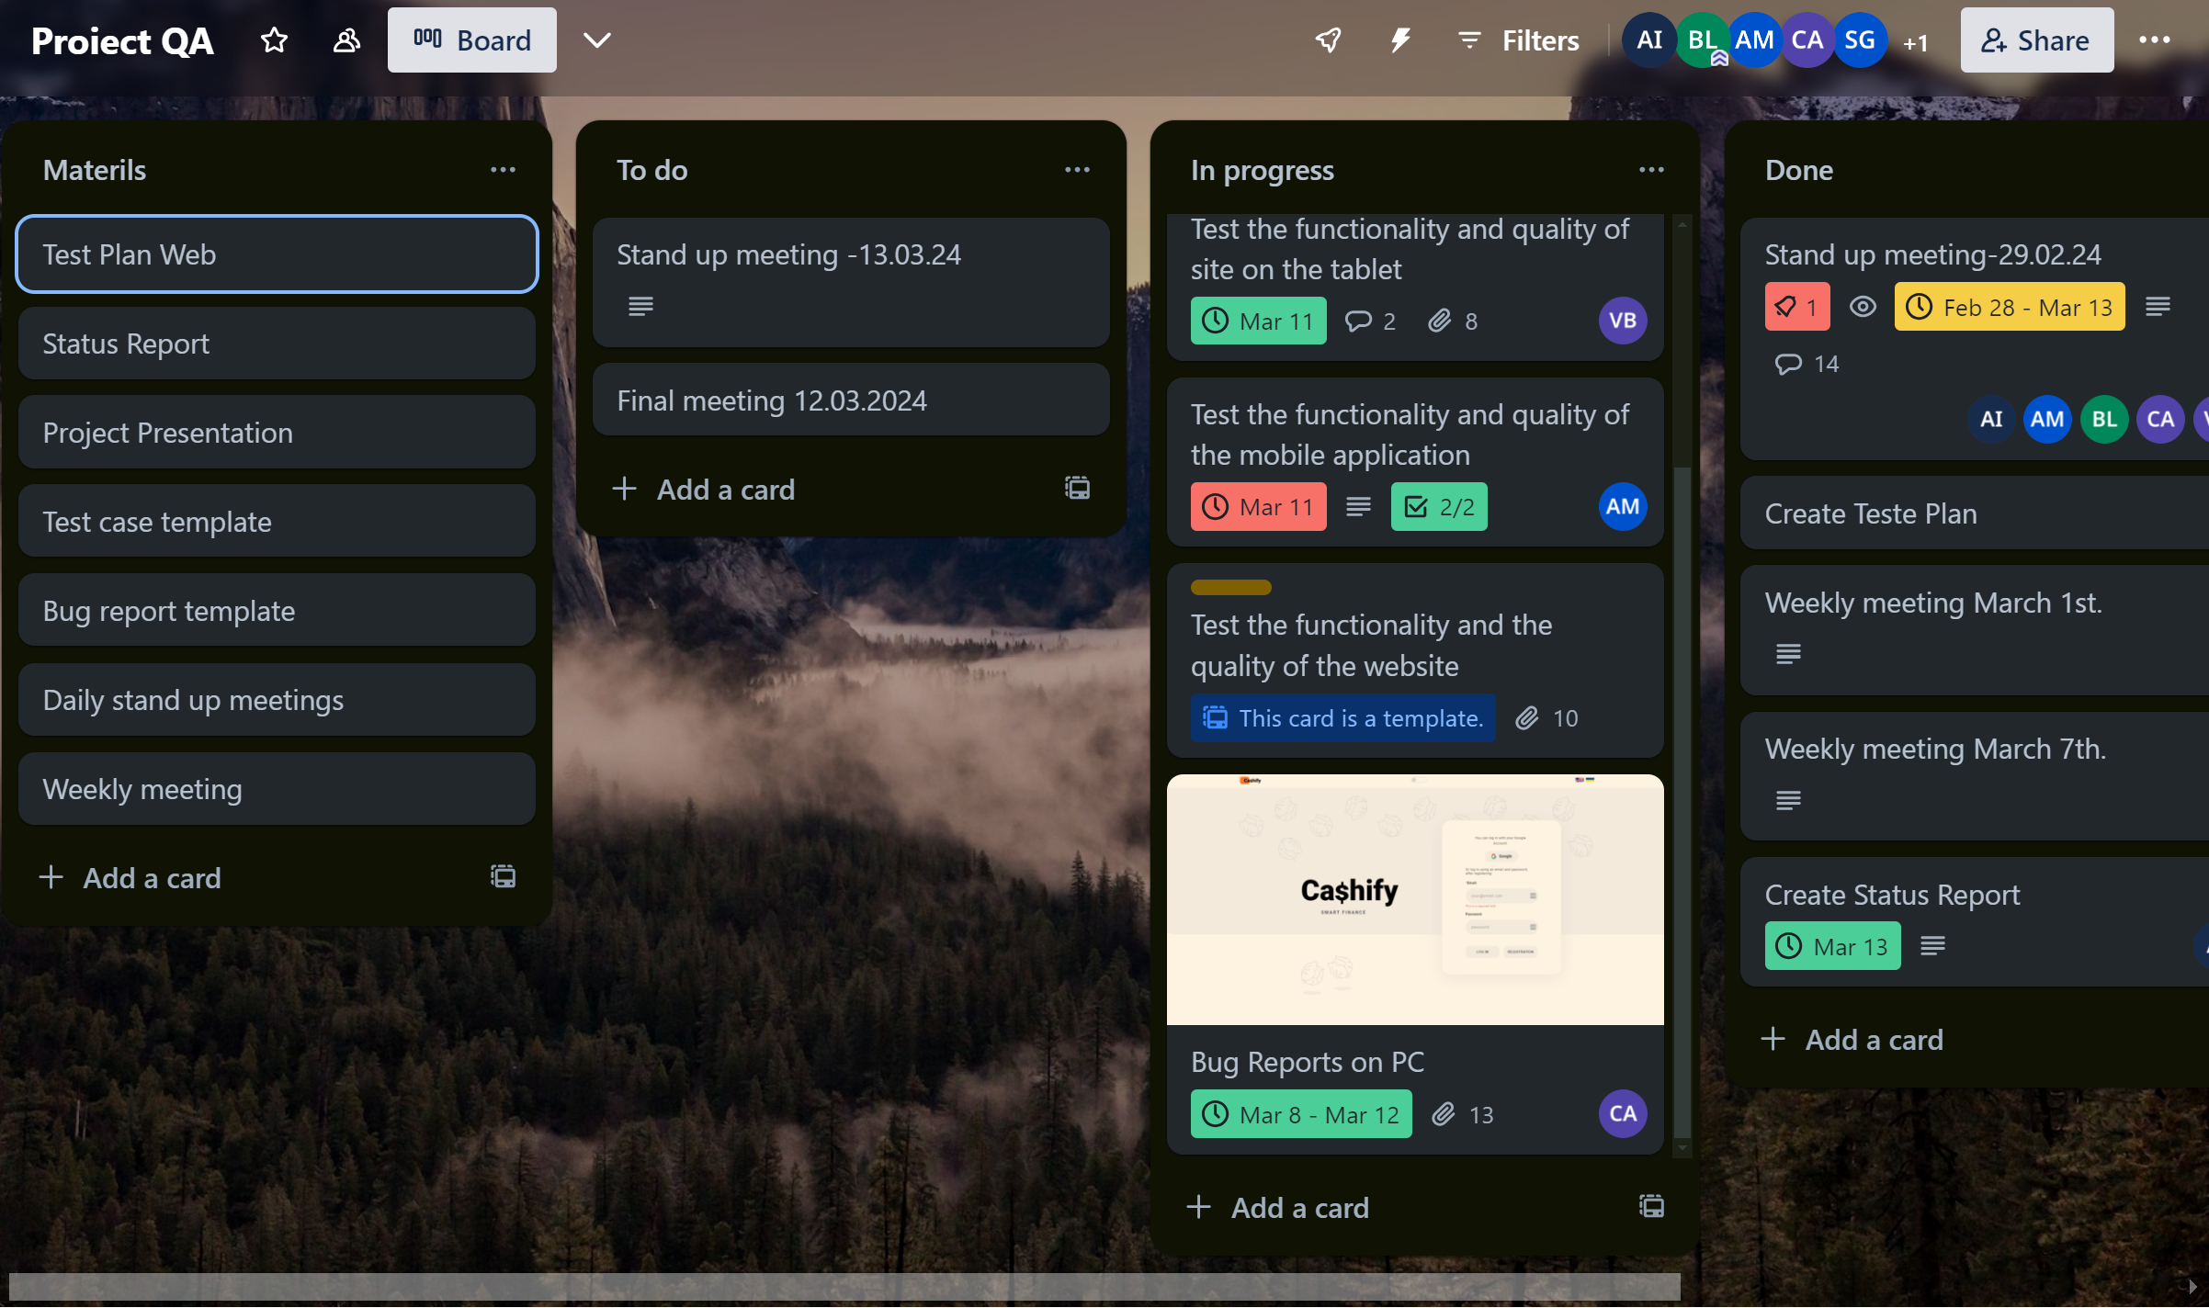
For a better communication we used Trello! This platform allows us to work apart but have all the updates together. Meeting plans, after meeting summary, tasks designated to each of us were managed here!

Slide 8
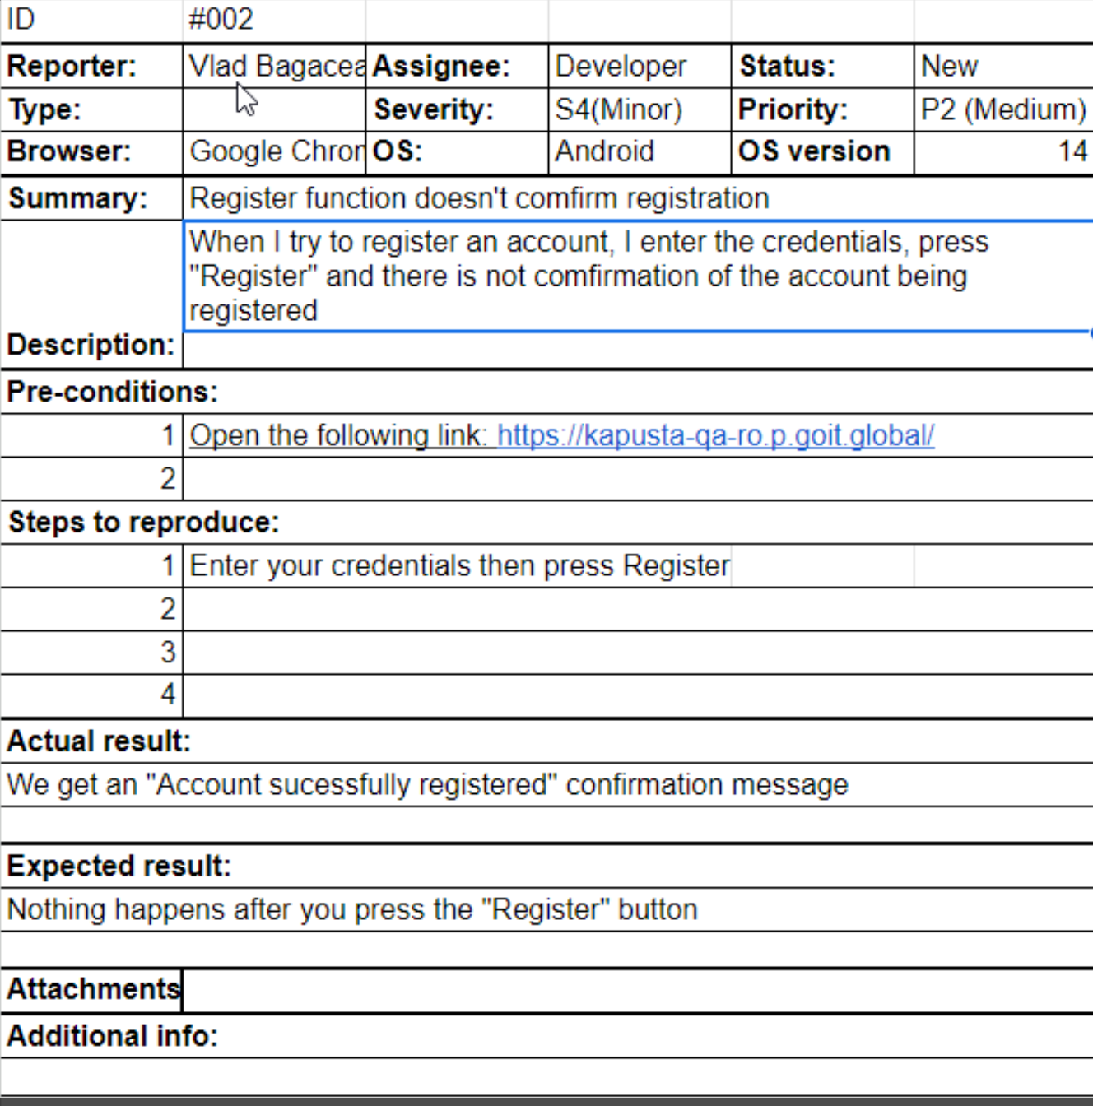
Test Case Example

Slide 9
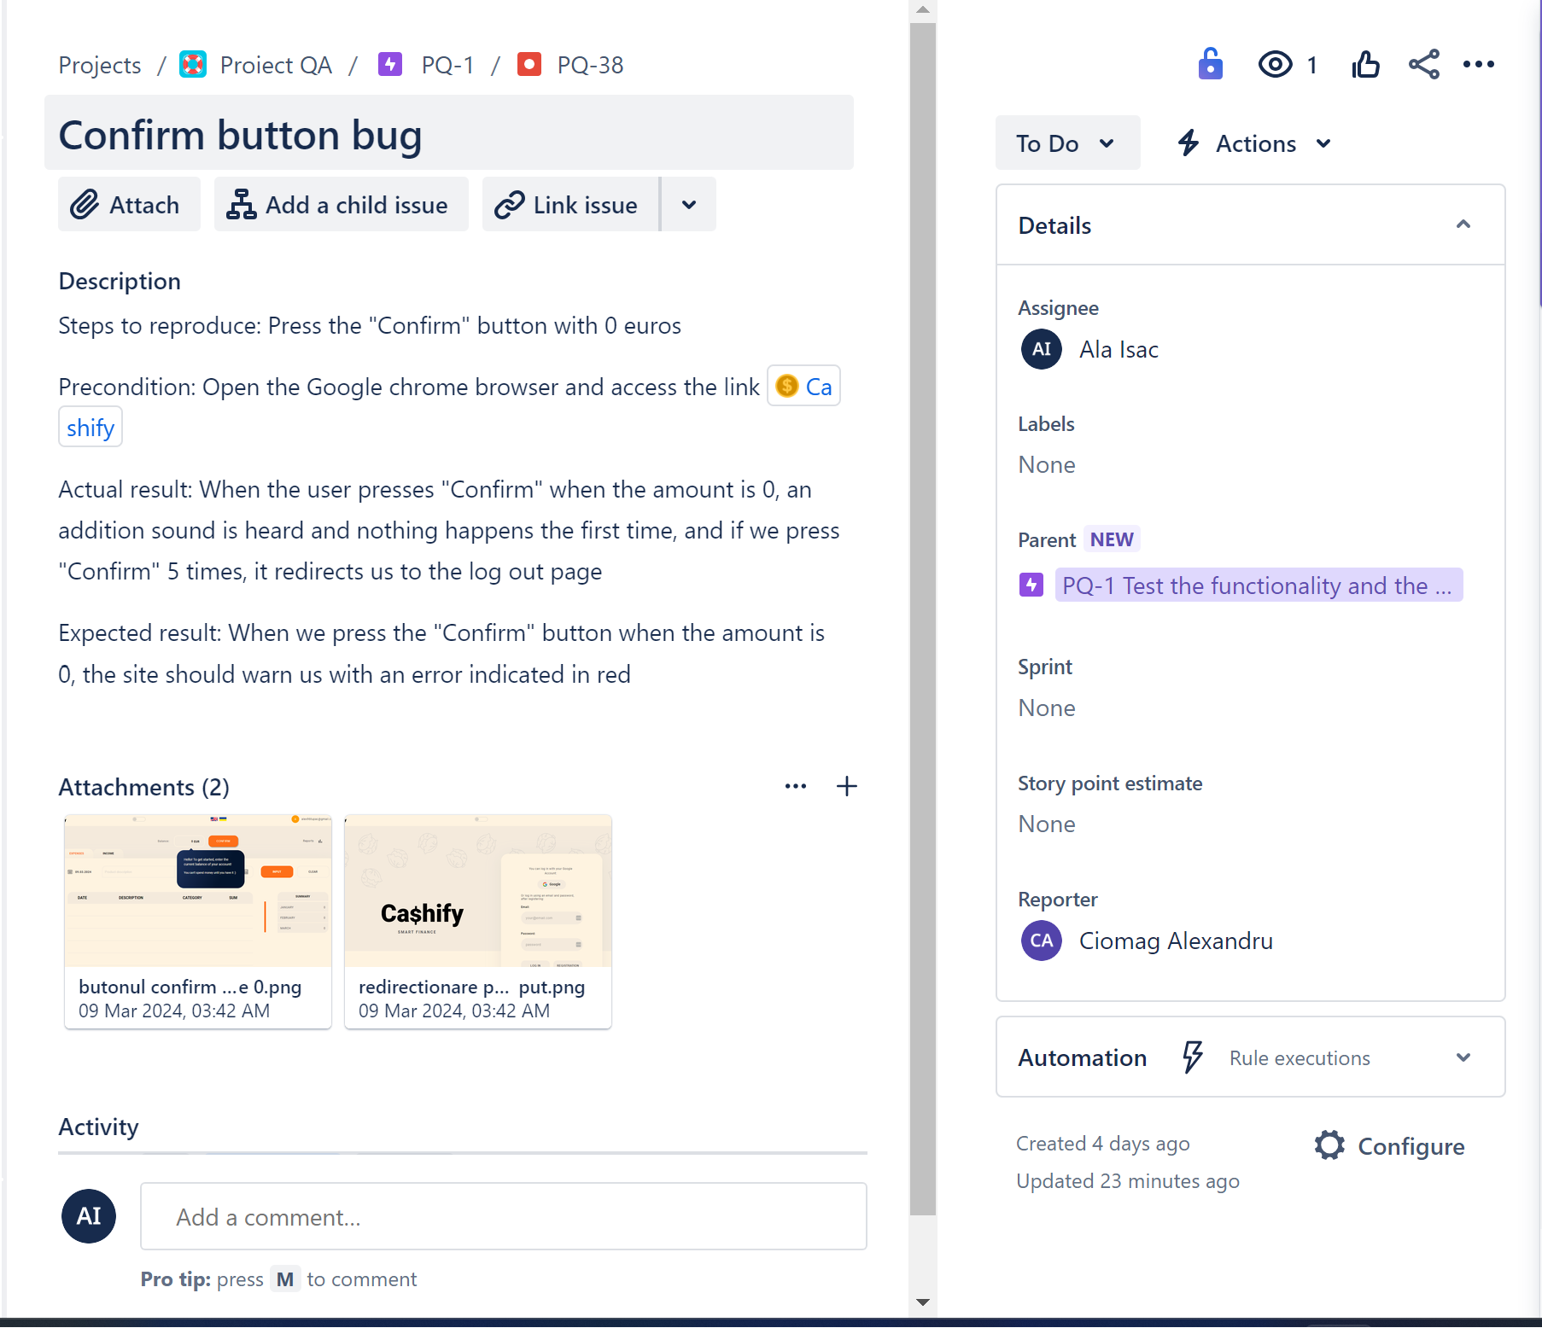
Summary Bugs Report
Identifying and recording bugs was a real challenge for the team as it was not difficult to find non-functional sections that did not comply with the requirements. We focused on documenting them as accurately as possible regarding the remediation of problematic categories.
Overall Status
Number of tests planned | 25
Number of tests executed | 25
Number of tests passed | 13
Number of tests failed | 12
Critical defects percentage | 0.83%

Slide 10

Here is our summary bug report and conclusion!
Considering the high percentage of functional defects, the product can not be recommended for use!

Slide 11
Accomplished Mission
Our team focused on implementing an effective teamwork method to improve test results, summarizing different test processes and categorizing tasks into different classes according to the test plan. We tried to optimize the level of collaboration and communication according to the needs of the project to achieve success and the desired result.
Cultivating Team Collaboration for Project Excellence
Our team focused on implementing an effective teamwork method to improve test results, summarizing different test processes and categorizing tasks into different classes according to the test plan. We tried to optimize the level of collaboration and communication according to the needs of the project to achieve success and the desired result.

Slide 12
Thank You!

